Slide 1
Multi-tenant in cloud computing

Slide 2
Multitenancy in Cloud computing :
Multitenancy is a type of software architecture where a single software instance can serve multiple distinct user groups.It means that multiple customer’s of cloud vendor are using same computing resources . As they are sharing same computing resources but the data of each Cloud customer is kept totally separate and secure.
in cloud computing Multitenancy also refer as shared host where same resources are divided among different customer’s.

Slide 3
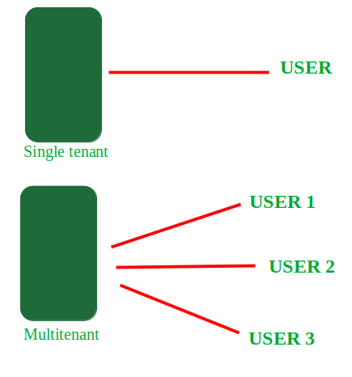
Single tenant-multitenant

Slide 4
Multitenant Cloud vs. Single-Tenant Cloud
In a single-tenant cloud, only one client is hosted on the server and provided access to it. Due to the multi-tenancy architecture hosting multiple clients on the same server, it is important to understand the security and performance of the provider fully. Single-tenant clouds give customers greater control over managing data, storage, security, and performance.

Slide 5
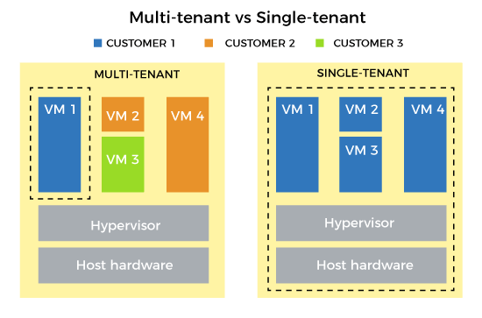

Slide 6
Multi-tenancy is an architectural pattern
A single instance of the software is run on the service provider’s Infrastructure
Multiple tenants access the same instance.
In contrast to the multi-user model, multi-tenancy requires customizing the single instance according to the multi-faceted requirements of many tenants.
A Multi-tenants application lets customers (tenants) share the same hardware resources, by offering them one shared application and database instance ,while allowing them to configure the application to fit there needs as if it runs on dedicated environment.

Slide 7
These definition focus on what we believe to be the key aspects of multi tenancy:
1.The ability of the application to share hardware resources.
2.The offering of a high degree of configurability of the software.
3.The architectural approach in which the tenants make use of a single application and database instance.

Slide 8
There are three approaches on how to build a multi-tenant application:
Database per tenant — each tenant has its database.
Shared database, separate schema — all tenants are using the same database, but each tenant has his schema.
Shared database, shared schema — all tenants are using the same schema.

Slide 9
Multi-tenants Deployment Modes for Application Server
Fully isolated Application server
Virtualized Application Server
Shared Virtual Server
Shared Application Server

Slide 10
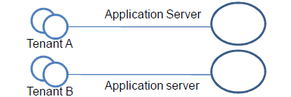
Fully isolated Application server
Each tenant accesses an application server running on a dedicated servers.

Slide 11
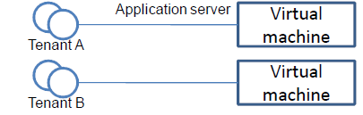
Virtualized Application Server
Each tenant accesses a dedicated application running on a separate virtual machine.

Slide 12
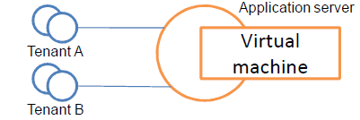
Shared Virtual Server
Each tenant accesses a dedicated application server running on a shared virtual machine.

Slide 13
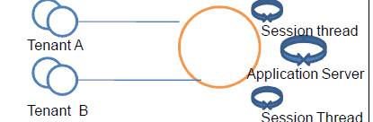
Shared Application Server
The tenant shared the application server and access application resources through separate session or threads.

Slide 14
multi-tenant data center
A multi-tenant data center, also known as a colocation data center, is a facility in which organizations can rent space to host their data. Businesses can rent to meet varying needs, from a server rack to a complete purpose-built module.

Slide 15
Multi-tenants Deployment Modes in Data Centers
Fully isolated data center
Virtualized servers
Shared Server
Shared Database
Shared Schema

Slide 16
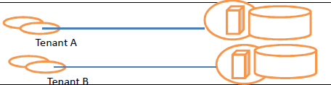
Fully isolated data center
Fully isolated data center the tenants do not share any data center resources

Slide 17
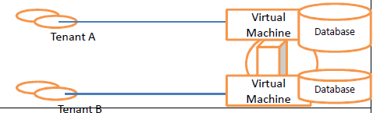
Virtualized servers the tenants share the same host but access different databases running on separate virtual machines

Slide 18
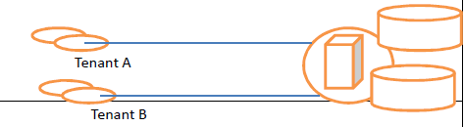
Shared Server the tenants share the same server (Hostname or IP) but access different databases

Slide 19
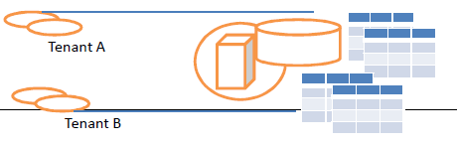
Shared Database the tenants share the same server and database (shared or different ports) but access different schema(tables)

Slide 20
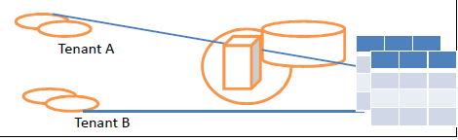
Shared Schema the tenants share the same
server, database and schema (tables). The irrespective data is segregated by key and rows.

Slide 21
Question
Payroll Processing in Cloud Computing
Many State Government departments are utilizing standardized set up of payroll packages which are deployed at user locations and it is amounting huge investment on procurement of hardware and software and maintenance for various locations of the organization.
Drawbacks :
Software Maintenance problems.
Individual Hardware is required.
Often Data Loss occurs.
Migrating the payroll package, to cloud environment can be worked out without changing business logic. Give an overview architecture of multi-tenancy for the above scenario.

Slide 22
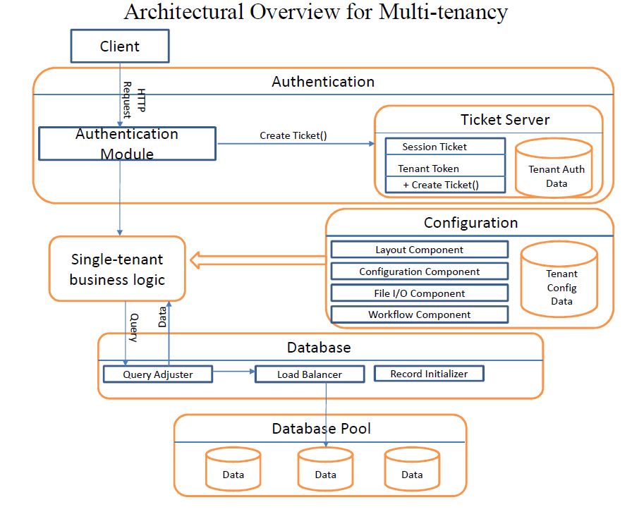

Slide 23
Provisioning for new tenants
For Separate server model new machine is to be installed.
For separate database model create a database start it on a server.
For separate schema and shared schema models scripts / stored procedure could create new schema in one of the existing databases.

Slide 24
The application is ideally suited to deploy in cloud environment with following features:
The application can be taken up as a single instance and multi-tenant model
Configurability option in the software is required to be provided.
Configurability in SaaS enables the flexibility to access the software by many tenants with the option of configuring each tenant for their application needs.
The software will have configurability for the following :
1.User interface.
2.Workflow.
3.Data.
4.Access control.

